Slide 1


A Presentation for B.Tech Final Year Project
Development of Digital Twin of
Submersible Pump for Preventive Maintenance
Group (M37) Members
Vikas Gaur(20213038)
Uttam Kumar Gupta(20213050)
Shushanshu K Bharti(20213133)
Umesh Kumar(20213140)
SUPERVISOR
Dr. Skylab P Bhore
(Associate Professor,MED)
Department Of Mechanical Engineering
Motilal Nehru National Institute of Technology(MNNIT), Allahabad,
Prayagraj,Uttar Pradesh-211004, India

Slide 2

Contents
Introduction
Motivation
Objectives
Methodology
Roadmap for 7th semester
Roadmap for 8th semester

Slide 3
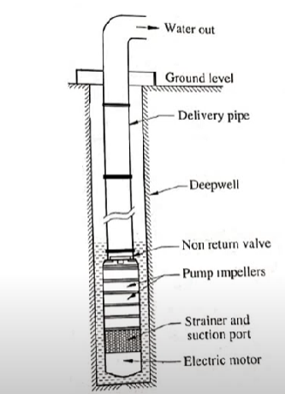
Introduction
A submersible pump is a device designed to operate fully submerged in liquid, efficiently pushing the liquid to the surface. Its sealed motor prevents water damage, making it ideal for various applications.
It has wide range of applications, including drinking water supply, industrial process, fire fighting, waste water management, irrigation.
PARTS OF SUBMERSIBLE PUMP
1. MOTOR
5. SHAFT
2. PUMP CASING
6. CHECK VALVE
3. IMPELLER
7. CABLE
4. DIFFUSER

Slide 4
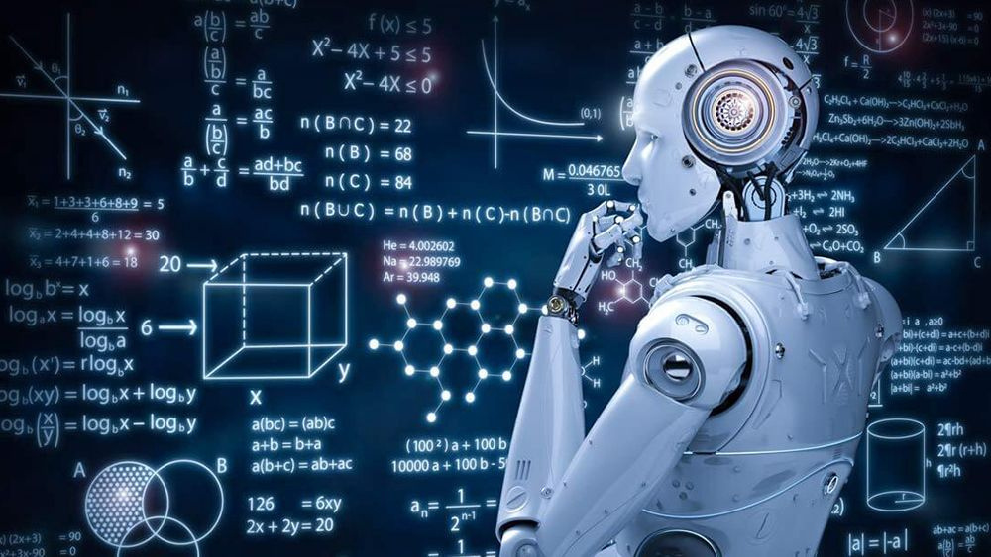
Motivation
Identification of Problem
Since Fault is not identified by conventional method, we can use ML model to predict the fault in the system
Using real-time data from an IoT network platform, we can create a virtual model as a digital twin powered by machine learning.
Prior Maintainance time

Slide 5
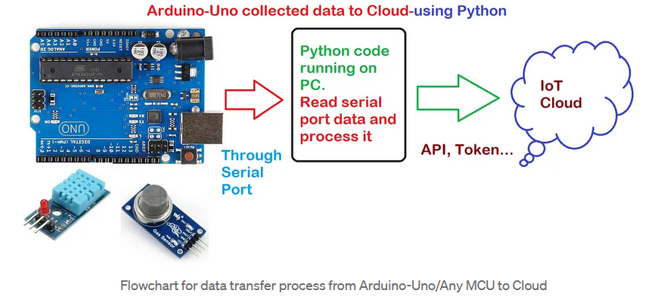
Objectives (What to do?)
Collection of data from
submersible pump test setup in lab
Development of data driven
ML Model
Development of Digital Twin
Prediction of faults and remaining life of system

Slide 6
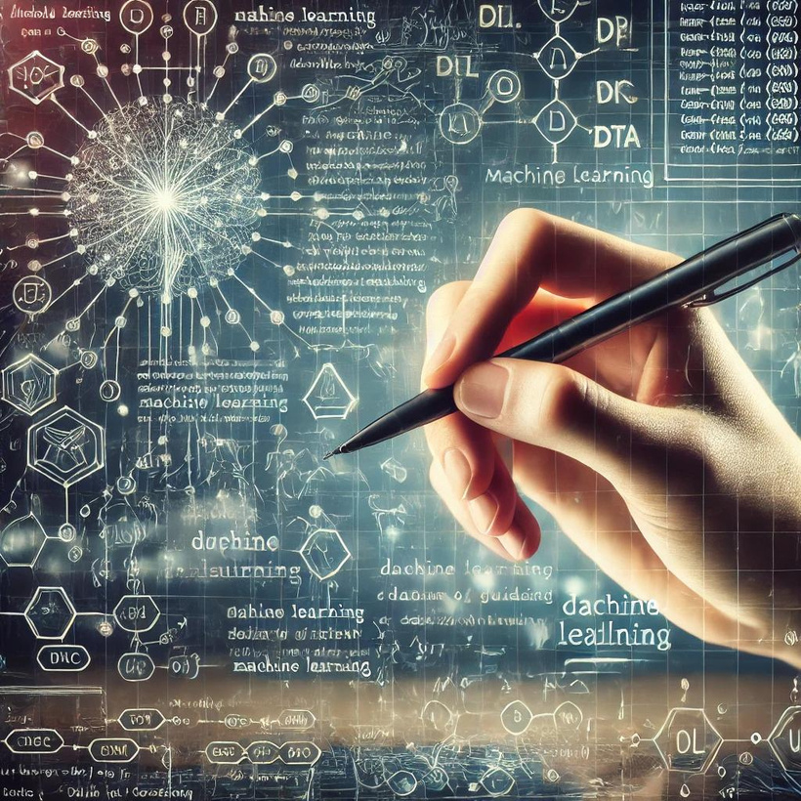
Methodology(How to do..?)
The setup has been there in Rotar Dynamic Lab
Uses of differnet Sensors for data acquisition and
sending it to cloud server
Utilising the concept of Machine Learning
Algorithm to analyse the data
Using the dynamic Data we can now Perform the Digital Twin of a Body With Indicating the Information

Slide 7

Roadmap for 7th Semester
01
02
03
Now connecting it with cloud
to get the data for various condition
Development of Data driven Machine Learning Model
Assembly of the setup
to be perform
04
05
appropriate measures to address the underline issues and prevent recurrence
Predict the remaining useful life of pump

Slide 8

Roadmap for 8th Semester
01
02
03
04
Establishment of IOT frame and acquire data from cloud
Import data from cloud to virtual model
Pin Point the specific point in the system , predicting the remaining life
Digital representation of the real time information of different data using sensors

Slide 9
Conclusion
The development of a Digital Twin for a submersible pump marks a significant advancement in the field of predictive maintenance
By creating a virtual replica of the physical pump, the system allows for real-time monitoring, data analysis, and predictive insights, leading to improved operational efficiency, reduced downtime, and enhanced decision-making processes. updates.

Slide 10

Thank you!

